Slide 1
Runoff

Slide 2
Runoff is that part of precipitation that appears in a drainage channel as surface flow in a perennial or an intermittent form.
It is that part of water, which can be used for engineering purposes and hence is also known as yield of catchment.
The yield from a catchment is generally expressed in terms of volume, in a season or a year.

Slide 3
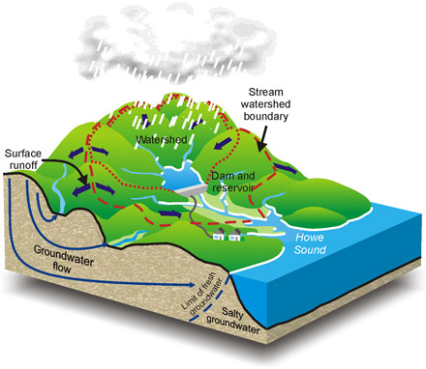
Catchment characteristics
the area from which the surface runoff is derived.
It is also known as the watershed area, drainage area, drainage basin or simply basin or catchment.

Slide 4
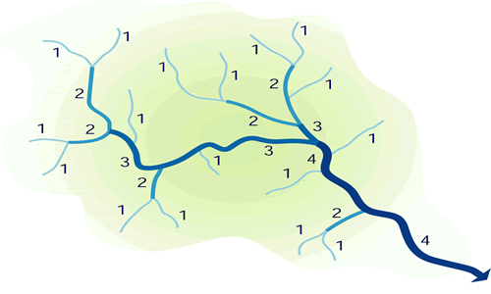
Catchment characteristics
Stream Order
The classification reflecting the degree of branching or bifurcation of stream channels within a basin.
The smallest drainage channels near their origin are grouped under Order 1. When two channels of Order 1 meet, a channel of Order 2 is formed. Similarly, when two channels of Order 2 meet, a channel of Order 3 is formed and so on. Thus, the order of the main stream indicates the extent of branching in the catchment area. It is dimensionless.

Slide 5
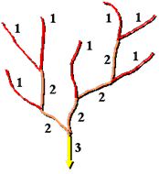
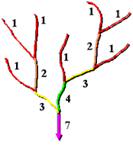
Catchment characteristics
There are two method you can use to assign orders, these are the methods proposed by Strahler (1957) and Shreve (1966)
Strahler stream ordering method
Shreve stream ordering method

Slide 6
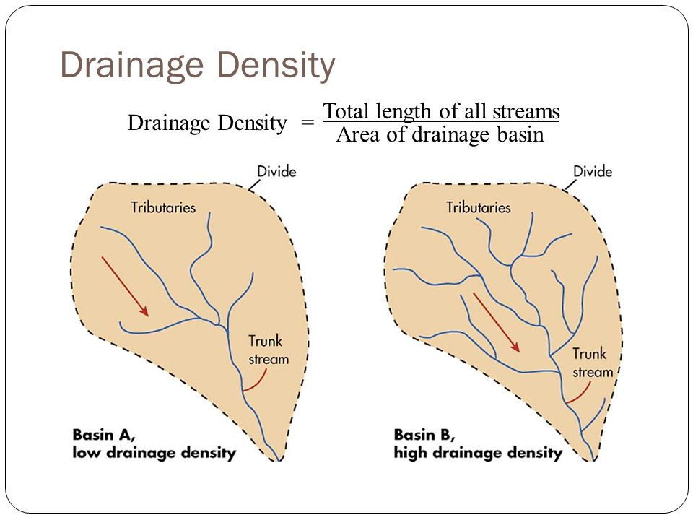
Catchment characteristics
Drainage density is the total length of all the streams and rivers in a drainage basin divided by the total area of the drainage basin.
It is a measure of how well or how poorly a watershed is drained by stream channels.
Low-drainage density indicates poor drainage conditions.

Slide 7
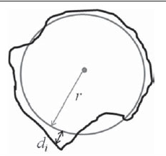
Catchment characteristics
Length of Stream
The length measured along the main stream from the catchment outlet to the remotest point on the catchment boundary is called the length of the stream or watershed length.
Naturally, the unit is expressed in meters.
Form Factor of Catchment Area
Form factor is defined as the ratio of the catchment area to the square of its length of the main stream. It is dimensionless
Circularity Ratio
Circularity ratio represents how a shape is similar to a circle. It is the ratio of the area of a shape to the shape’s perimeter square. It is dimensionless.

Slide 8
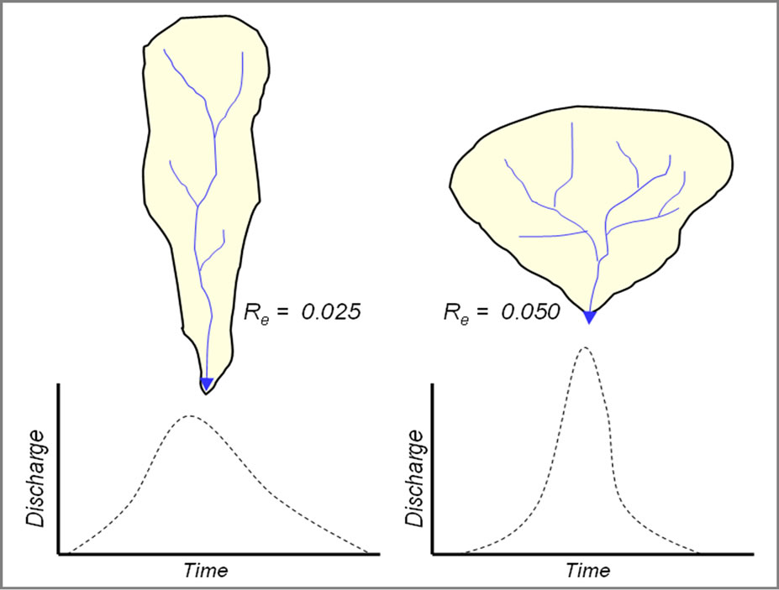
Catchment characteristics
Elongation Ratio of the Catchment Area
The elongation ratio of a catchment area is defined as the diameter of a circle whose area is equal to the catchment area divided by the length of the basin. It is dimensionless.

Slide 9
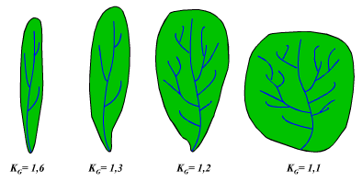
Catchment characteristics
Shape Factor
The shape factor is the ratio of the square of the watershed length and the watershed area. It is dimensionless.
Relief of Catchment Area
The relief of a catchment area may be defined as the difference in elevations between the highest point on the ridge line and the basin outlet. The units would be expressed in meters.

Slide 10
Catchment characteristics
Relation of Catchment Area with Its Length
After analyzing a number of catchment areas, the following relation is noticed.
L = 1.2736 A^{0.6}
where, L = Length in kilometer of the main channel
A = Catchment area in km²
Classification of catchment area
The catchment areas are classified depending upon the shape as:
Fan shape
Fern leaf-type or elongated

Slide 11
Catchment characteristics
Fan shape: The shape of a catchment may be similar to a fan, i.e. circular.
Fern leaf-type: The shape of a catchment may be similar to a fern leaf, i.e. elongated.

Slide 12
Catchment characteristics
Classification of streams
The streams may be classified as follows:
1. Influent Stream
When there is flow in a channel and the groundwater table is lower than the water level in the river, water from the channel may flow into the groundwater storage. A stream that feeds some flow to the groundwater storage is known as influent stream.
2. Effluent Stream
If the groundwater table level is higher than the water level in the channel then water may flow from the groundwater to the channel. A stream that receives some flow from the groundwater storage is known as effluent stream

Slide 13
Catchment characteristics
Intermittent Stream
A stream that acts as an influent stream for some period in a year and for the rest of the period as effluent stream is called as intermittent stream.
Ephemeral Stream
A stream that carries discharge in rainy days only and dries during hot weather is known as ephemeral stream or seasonal stream.
Perennial Stream
A stream that carries discharge throughout the year is known as perennial stream.

Slide 14
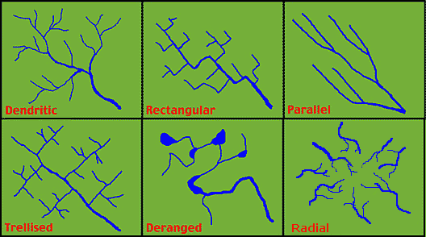
Catchment characteristics
STREAM PATTERNS
The combined effect of climate, soil structure and geology of the catchment area is noticed in the network of channel or stream pattern. The usual patterns observed are as follows:
Dendrite type or tree like
Rectangular
Parallel
Trellis pattern
Deranged
Radial pattern
These stream patterns have a significant effect on the draining period and the flow intensity of the surface runoff and indirectly on infiltration and total runoff.

Slide 15
FACTORS AFFECTING RUNOFF
The factors affecting the runoff are as follows:
Precipitation
Size and shape of catchment
Geographical characteristics of the catchment
Meteorological characteristics of the catchment
Effect of drainage net
Other factors

Slide 16
The runoff from a catchment is estimated by the following methods:
Standard tables
Empirical formula
Rainfall runoff correlation
All these methods give a rough estimate, since none of them is accurate.

Slide 17
- Standard Tables
Observations of precipitation and the resulting runoff were taken for a number of catchments having different characteristics. Tables are prepared showing the relation between precipitation and the resulting runoff, taking into consideration the catchments. The following tables are in use.
1. Binnie’s table
Sir Binnie suggested runoff as a percentage of total annual precipitation by observing rivers in Madhya Pradesh, India, as follows:

Slide 18
Binnie’s table
The observations covered areas that were not having heavy rainfall but were having a precipitation up to 1100 mm. Hence, these percentages are not applicable for high-rainfall areas.
Serial no. | Average annual rainfall in the catchment (mm) | Runoff % of annual rainfall
1 | 500 | 15
2 | 600 | 21
3 | 700 | 25
4 | 800 | 29
5 | 900 | 34
6 | 1000 | 38
7 | 1100 | 40

Slide 19
Example 1
The average annual precipitation over a catchment of 120 km² and its percentage is as follows: Find the runoff from the catchment using Binnie’s table.
Serial no. | % of area | Average annual precipitation (cm)
A1 | 20 | 50
A2 | 15 | 75
A3 | 40 | 90
A4 | 25 | 110
Solution:
The Binnie’s coefficients corresponding to the average annual precipitation for each area and the corresponding runoff will be as follows:

Slide 20
Rainfall-Runoff correlation
Runoff is correlated to rainfall as follows:
Runoff = K × (annual rainfall)
where, K = Constant and its value for various types of catchment areas are shown in table below
This method is applicable mainly to small urban catchment areas.
Serial no. | Type of catchments | Value of K
1 | Urban | 0.05–0.5
2 | Forest | 0.2–0.5
3 | Commercial and industrial | 0.9
4 | Parks and farms | 0.3–0.5
5 | Concrete pavements | 0.85

Slide 21
A catchment area of 150 km² has the following type of distribution:
Find the annual runoff from the catchment when the average annual precipitation is 90 cm.
Area | Type | %
A1 | Urban | 20
A2 | Forest | 35
A3 | Commercial and industrial | 30
A4 | Concrete pavement | 15
Solution:
The runoff coefficient K for the respective type of catchment and the annual runoff from each type of catchment will be as follows:

Slide 22
Rainfall-Runoff correlation
The relationship between rainfall in a period and the corresponding runoff is quite complex and is influenced by a host of factors relating to the catchment and climate.
One of the most common methods is to correlate seasonal or annual measured runoff values (t) with corresponding rainfall (P) values.
A commonly adopted method is to fit a liner regression line between R and P and to accept the result if the correlation coefficient is nearer unit.
The equation of the straight-line regression between runoff R and rainfall P is:

Slide 24
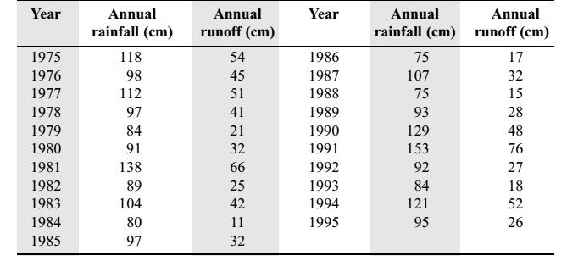
Example 2
Annual rainfall and runoff volume (cm) of a catchment spanning a period of 21 years are given below. Develop a linear correlation equation to estimate annual runoff volume for a given annual rainfall value.

Slide 25
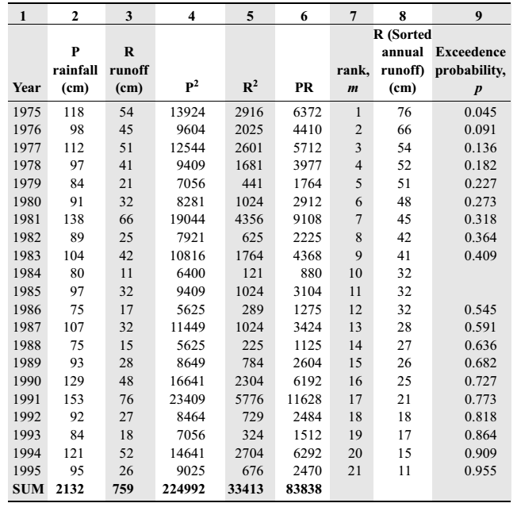
Solution

Slide 27
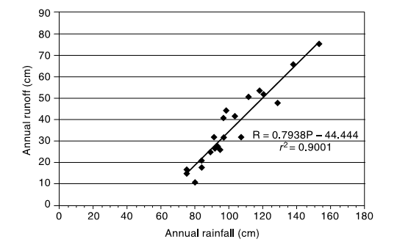

Slide 28
SCS-CN method
SCS-CN method, developed by Soil Conservation Services (SCS) of USA in 1969, is a simple, predictable, and stable conceptual method for estimation of direct runoff depth based on storm rainfall depth.
It relies on only one parameter, CN.
This method is based on the water balance equation of the rainfall in a known interval of time Δt, which can be expressed as
$$P=I_{a}+F+Q$$
1
Precipitation
Initial abstraction
Direct surface runoff
Cumulative infiltration excluding I_{a}

Slide 29
SCS-CN method
Two other concepts are also used with eq. 1
The ratio of actual amount of direct runoff (Q) to maximum potential runoff (= P – I_{a}) is equal to the ratio of actual infiltration (F) to the potential retention (or infiltration), S.
The amount of initial abstraction (Ia) is some fraction of the potential maximum retention (S). Thus
2
3

Slide 30
SCS-CN method
Combining 2 & 3 and using 1
Curve Number (CN): The parameters S representing the potential maximum retention depends upon the soil-vegetation-land use complex of the catchment and also upon the antecedent soil moisture condition in the catchment just prior to the commencement of the rainfall event. The S in terms of CN is defined as:

